Slide 1
PUBLIC PARTICIPATION ON THE CONTINOUS PROFESSIONAL DEVELOPMENT PROGRAMMES GUIDELINES 2024 & REGULATORY IMPACT STATEMENT
Presentation to KISM Membership & other Stakeholders

Slide 2
KISM’s Journey towards SCM Excellence
Evolving SCM in Kenya and Beyond
Our Journey thus far: Key Milestones
Revamping our Continuous Professional Development
Overview of CPD Guidelines
Overview of Regulatory Impact Assessment
Benchmarking with other Professional Bodies
Discussion

Slide 3
Our Journey thus far…

Slide 4
Work-in-Progress
2023-25
Key Milestones: ‘2020-2022’
Launch of KISM Strategic Plan 2020-2024
KISM Strategic Plan Road Map
Vision: Competent & Ethical Supply Chain Mgmt Practitioners
Ongoing Projects
KISM College of SCM
KISM Regional Chapters
Revamping CPD Policy
SCM Bill 2024
Pan-African Centre of SCM Excellence
Research & Consultancy Hub
Membership Advocacy & Welfare Association
Procurement Auditors
SCM Board Representation
SCMP Bill 2024
Finished Projects Ongoing Projects Upcoming Projects
Inauguration of KISM Towers
KISEB Operationalization
Electronic Voting
Launch of Revised Glo-Cal Curriculum
Mentorship & Coaching
Developing Strategic Partnerships
KISM Mashinani
Entrenching CPD Policy
Disciplinary Policy & Procedures
Automation Membership Registration & Licensing
Launch of Wanunuzi sacco

Slide 5
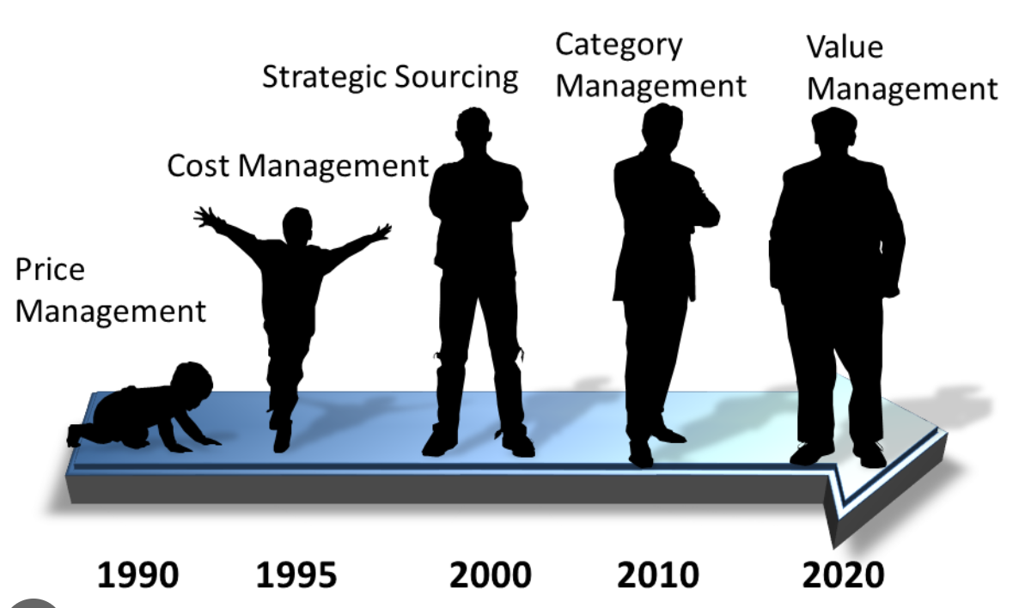
SCM is more that just price and cost negotiations …
SCM must be viewed as integral/value adding to business…

Slide 6
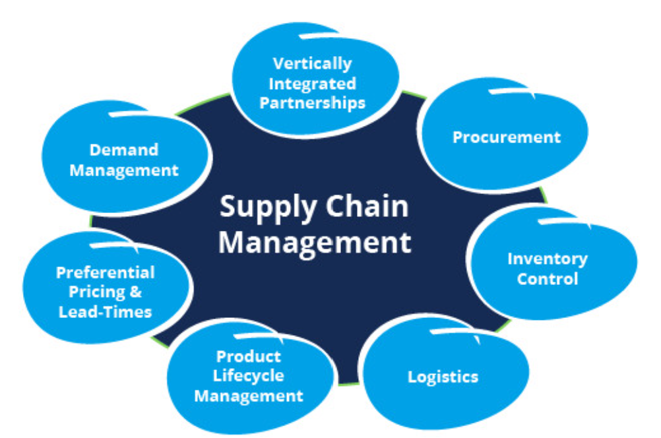
Supply Chain Management must be viewed wholistically & strategically…
SCM is an end-to-end Sourcing process…

Slide 7
Evolution of Supply Chain Mgmt in Kenya…
3
4
5
6
1
2
Public Procurement Regulations, 2001
Public Procurement & Disposal Act, 2005
Constitution of Kenya, 2010 & PPADA 2015
SPMA 2007
Treasury Circulars From 1955
Supplies
Manual,
1978
Digital Gig
eGP, PPADR 2020; PPADA 2022

Slide 8
Who We Are…
The Supplies Practitioners Management Act 2007, (SPMA) establishes the following bodies to govern the SCM Profession:
KISM is mandated to Register, License, Discipline, Train and Regulate Supply Chain Management Practitioners in both private & public sectors
KISEB is mandated to conduct examinations for professional supplies certification

Slide 9
Regulatory & Legal Framework of SCM in Kenya
The Regulatory & Legal Framework governing Procurement in Kenya is governed by three bodies
The National Treasury(Ministry of Finance) Cabinet Secretary
Policy formulation and overall responsibility
Public Procurement Regulatory Authority: Processes & Procedures
Public Procurement Administrative Review Board
KISM is mandated to Register, License, Discipline, Train and Regulate Supply Chain Management Practitioners in all Sectors
KISEB is mandated to conduct examinations for professional supplies certification

Slide 10
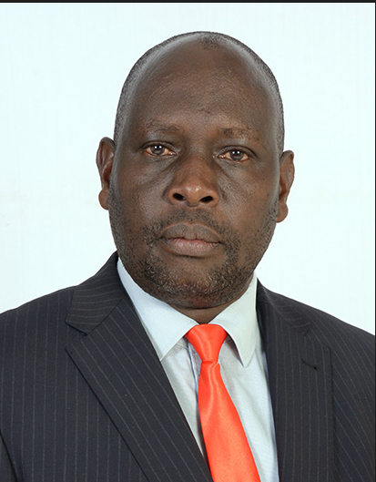
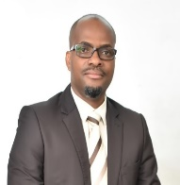
Elected & Nominated Council Members
CM Martin Omuse
Alt. CS NT
CM Henock Kirungu
Alt. DG PPRA

Slide 11
KISM’s & KISEB Mandate…
SCM is among the recognized professions in Kenya, and we owe this recognition to the Supplies Practitioners Management Act of 2007 (SPMA), the Public Procurement and Asset Disposal Act of 2015. Article 227 of the Constitution
The SPMA established the Kenya Institute of Supplies Management (KISM) and Kenya Institute of Supplies Examination Board (KISEB)
KISM is mandated to Register, License, Discipline, Train and Regulate Supply Chain Management Practitioners
KISEB is mandated to conduct examinations for professional supplies certification

Slide 12
KISEB Revised Glo-cal Curriculum…
KISEB Revised world class Curriculum CPSP-K Professional Diploma & APS-K Diploma) launched in 2021
Developed and Reviewed by experienced supply chain professionals, academics, thought leaders and Kenya Institute of Curriculum Development.
Accredited by Kenya National Qualification Authority (KNQA) and International Federation of Purchasing and Supply Management (IFPSM)
The qualifications borrows from world class best standards with local contextualization (Glo-cal) to create the standard for the supply chain profession
Over 7,000 students registered for CPSP-K & APS-K so far
72 Training institutions accredited: from Kenya, Angola, South Sudan, Somalia, Burundi, Rwanda, Somaliland and growing…

Slide 13
Our Strategic Plan 2020-24 Highlights…
We have laid the Infrastructural Foundation to take KISM to the next level:
KISM Towers: Centre of SCM Excellence:
Home to KISM, KISEB, PPRA & PPRB
Strategic Plan 2020-24
Institutional Capacity Strengthening
Key Pillar: Membership: No Member, No KISM

Slide 14
KISM Strategic Plan Map 2020-2024
Our Vision
Empowered, Competent and Ethical Supply Chain Management Practitioners
Our Goal:
Empowered, Competent & Ethical Supply Chain Management Practitioners
Our Mission
To Train, Register, License, Discipline & Regulate Supply Chain Management Practitioners
Balance Score Card
Our Values
Integrity
Accountability
Fairness
Transparency
Governance
Professionalism
Inclusivity
Innovativeness
Our Strategic Focus Areas
Membership Registration/Licensing
Membership Discipline
Regulation of Practitioners
Membership Welfare
Training & Capacity Bldg
Financial Sustainability
Institutional Strengthening
Financial Health and Sustainability
Financial
Customers
Empowered and satisfied Members/customers
Internal/ Process
Our Strategic Drivers
Customer Experience
Operational Excellence
Employee Engagement
Financial Sustainability
Corporate Social Responsibility
Efficient and Effective processes
Learning and Development
Motivated and competent workforce

Slide 15
Looking Ahead…What is on the horizon?
Brethren, I do not regard myself as having “Achieved” it yet; but one thing I do: forgetting what lies behind and reaching forward to what lies ahead, I press on toward the mark for the prize of the high calling of God in Christ Jesus. Phil. 3:13‭-‬14

Slide 16
2023-2026 Key Focus Areas
Stawisha KISM Mashinani:
Operationalisation of Regional Chapters
Stawisha Utalaamu:
Impactful Professional Development
Full Automation Membership Registration & Licencing
Enhanced Collaborations with County Governments
Stawisha Usimamizi Wa Taasisi Na Mageuzi Ya Kisheria
Governance: Legal
Reforms & Institutional Strengthening
Strategic Partnerships & Collaborations
Membership Welfare and Advocacy
1

Slide 17
CPD has to be Personal & Intentional…

Slide 18
Rethinking our CPD Programs…
WE EMBRACE A PULL BASED APPROACH TO OUR TRAININGs
Training programs must be informed by :
Members Needs
Market needs and
Emerging Amendments

Slide 19
Background: Entrenching CPD Programs
Continuous Professional Development 1st introduced in 2020: Focus on entrenching professionalism & continuous professional development; reviewed in 2021 but evidence of public participation not presented in court
Enriched & expanded options for practical & relevant training for Members; free CPD points opportunities; continuous review of charges to ensure affordability, free trainings
Accreditation Policy of Partner Trainers introduced in 2020 for the 1st time;
Continuous Training Needs Analysis & Segmentation:
Regional/County/Inhouse focused and specialized trainings
Training Team’s Effectiveness: TOTs for Facilitators ongoing process
Digital Learning Platforms/Webinars/Research to expand scope for CPD points
Enrich CPD Training with a focus on rich, Industry-specific and Governance contents and emerging areas in Supply Chain Management

Slide 20
Why Continuous Professional Development?
A commitment to CPD is an integral part of being a professional.
CPD is ‘the systematic maintenance and improvement of knowledge, skills and competence throughout a professional’s working life.’
Capacity Building for all actors in the SCM process is critical in entrenching professionalism, skills and competences for optimal service delivery
CPD is critical for SCM Professionals since it helps us to remain relevant, broadens knowledge, refreshes best practice & keeps us upto date with changing dynamics, legislations & new developments

Slide 21
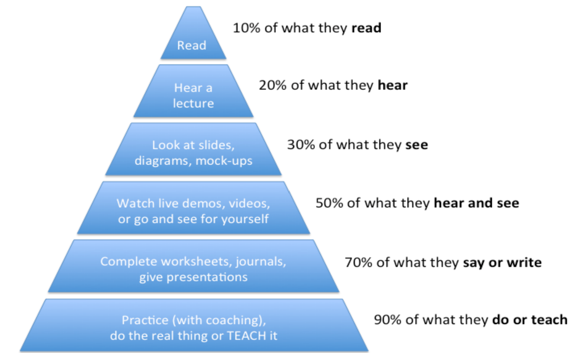
Recalibrating Delivery of CPD Trainings -/1
Focus on relevance, active engagement, and self-directed learning.
Utilize multimedia, technology, and peer collaboration.
Recognize prior experiences, set clear objectives, provide regular feedback & emphasize practical application.
Create a supportive environment, vary instructional methods & offer flexibility in learning formats.
Encourage reflection, use adult learning principles & celebrate achievements
Reinforce the value of the learning experience

Slide 22
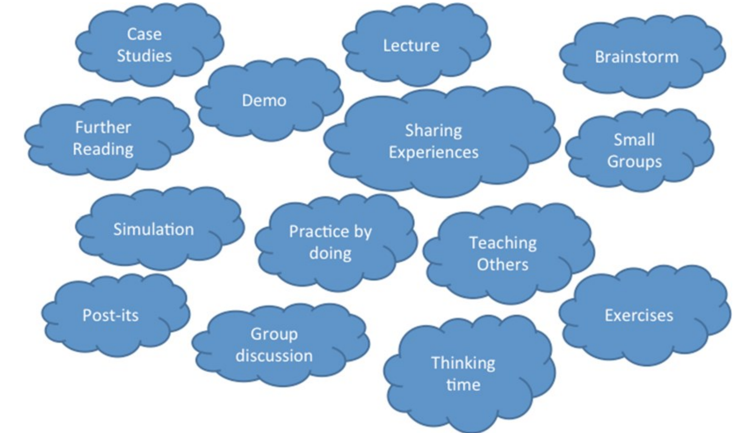
Recalibrating Delivery of CPD Trainings -/2

Slide 23
Recalibrating our CPD Programs
Conducting Regular Training Needs Assessment
Define Clear Learning Objectives
Diversify Learning Formats
Leverage & Utilize Technology
Collaborate with Industry Experts
Incorporate Soft Skills Training
Create Specialized Certifications
Promote Peer Learning & Collaboration
Provide Resources for Self-Directed Learning
Implement a Feedback & Evaluation Mechanism
Implement a Recognition & Rewards Scheme
M&E for improvement
Agility & Responsiveness
Notes:
23

Slide 24
What is in the horizon: We are not there yet…

Slide 25
CPD Strategy for 2024-2026…
Launch CPD 2.0 program:
Revamp the CPD programs in line with emergent training formats – from online content, sponsored networking events and Co-developed training programs with various institutions.
Ramp up access to free content and trainings that will enable members access training.
Introduce training programs targeted at HOPs and Accounting Officers
Introduce free/subsidized workshops
Partner with local, regional and international organizations to provide access to conferences at a discounted fee for KISM members
Establish a symbiotic relationship between Licensed Firms, Consultants…
Value for Money
Partner with organizations such as GoK, IFC, UNWOMEN, KSG, EACC etc, to sponsor training to share the burden of the training fees.
Introduce payment plans for our members. “Lipa Mdogo Mdogo’’
Elimu Kwa Wote: our CPD programs to suit the differentiated member value propositions. Tailor-make the needs in line with the unique member segments (Public/ private/ humanitarian/ Logistics etc. and career journey.
The SCM career path defined: Online competency framework and assessment tool for use by members and sponsoring institutions
Certification in Ethics and Emerging issues: access to relevant content and certification (anti competition, data protection, sustainability, ethics, Blue Economy and Circular Economy etc.)
Elimu Mashinani:
Devolve training, workshops and seminars to county levels for easy access.
Build capacity of trainers in the regions.
Elimu Kwa Wanunuzi:
Fully Operationalize the Kenya College of Supply Chain Management.
Develop an all inclusive curriculum covering all the disciplines in Supply Chain Management.

Slide 26
RPL is finally here
Recognition of Prior Learning (RPL) or Prior Learning Assessment (PLA) or Recognition of Prior Learning and Experience (RPLE) is a process that acknowledges and gives credit to an individual's existing skills, knowledge, and experience that they acquired over their working life, formal or informal

Slide 27
Importance of RPL
The objective is to undertake extensive review of the Recognition of Prior Learning (RPL) program that will identify, assess and certify knowledge, skills and attitudes in the public procurement sector
Promotes Lifelong Learning
Fairness and Inclusivity
Time and Cost Efficiency
Workforce Development
Encourages Adult Education
Enhances Employability
Aligns with Competency-Based Education
Supports Non-Traditional Learners
Globalization and Mobility
Encourages Diversity in Education
Motivates and Empowers Learners

Slide 28
FKISM: Celebrating SCM Professionals in Kenya
FKISM is the highest grade of KISM membership that recognizes excellence, outstanding levels of achievement, expertise, knowledge and experience, sustained commitment to the furtherance of the SCM Profession
It is a prestigious and advanced membership status awarded to individuals who have demonstrated significant achievements, contributions, and leadership within the SCM profession.
Being awarded the FKISM status is an earned recognition of significant development or outstanding contribution to the advancement of the profession, locally, nationally or internationally
FKISM: Fellowship Programme for Excellence in Supply Chain Management

Slide 29
KISM College of Supply Chain Mgmt…
The KSSCM already registered & accredited by the Technical and Vocational Education and Training Authority (TVETA)
Aimed at increasing product offering to Members to improve the marketability of SCM Professionals
All inclusive courses in SCM: CPSP-K, APS-K, certification courses such as CIPS, CILT, APICS/ASCM, VCARE, ITC, ICS, Clearing & Forwarding, Warehouse & Inventory Mgmt, E-Learning platforms
Marketing & Sensitization: The School has attracted interest from other African countries…Our Pan-African Centre of Excellence

Slide 30
KISM Research & Consultancy Hub…
Aims to establish Centre of Excellence Hub focusing Research, Consultancy & Resource Mobilization
Create Consortium of SCM Consultants to Leverage on members’ experience and create opportunities, expand network with other professionals and generate bankable & fundable research proposals
Undertake industrial & economic studies & research to help policy makers keep pace with the everchanging business environment
Partnership with International Organizations to make KISM the Pan-African Centre of SCM Excellence

Slide 31
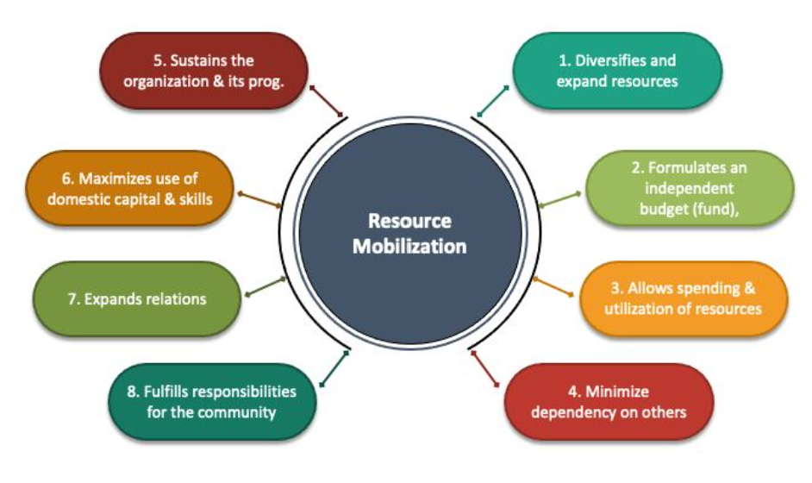
KISM Resource Mobilization Strategy
Financial Sustainability
Capacity Building
Advocacy and Representation
Networking Opportunities
Research and Publications
Professional Standards and Ethics
Public Awareness and Education
Member Services
Adaptation to Changes

Slide 32
Overview of the CPD Guidelines
The proposed Guidelines are divided into:
Preliminary provisions;
Provision of CPD Programmes
Accreditation of CPD programmes
Miscelleneous Provisions

Slide 33
Legal Guiding Provisions for CPD
Since the Institute exists in perpetuity, the Council in compliance with the Court ruling and guided by Section 16(10) of the Supplies Practitioner Management Act, 2007which states that, “…a member of the Institute shall be required to undergo such continuous professional development programmes as may be prescribed by the Council…” resolved that in the interim, the Institute shall enforce the above provision of the said Act as prescribed.

Slide 34
Preliminary Provisions
Preliminary matters which include the citation, interpretation and purpose of the Guidelines. Key to note are:
Accreditation
CPD Hour
CPD Year
Structured programmes
Unstructured programmes

Slide 35
Professional Standards Committee
Section 7 (as read together with paragraph 1 of the first schedule) of the SPMA provides the power to delegate functions of the Council to Committees. The composition is 3 Council Members.
The main function is to oversee all matters pertaining to CPD Programmes.

Slide 36
Types of Programmes
Structured – Obtained through formal training e.g workshops, webinars, conferences etc
Unstructured – obtained in a manner other than formal training. E.g probono services, publication of journals, articles on SCM, participation in Institute activities.

Slide 37
CPD HOURS
CPD hours are also known as CPD points, CPD units, or CPD credits. They are used by professional bodies to assess a professional's commitment to continued professional development.
I hour of active learning = I CPD Hour
The guidelines propose the use of hours.

Slide 38
CPD HOURS
Total CPD Hours = 40 minimum
Divided into:
Structured – 34
Unstructured – 6
Cross-referenced with other bodies Legal framework e.g LSK – Units, ICS – points, ICPAK – hours, IHRM - points

Slide 39
CPD Calendar
The CPD Calendar shall be approved no later than 60 days to the close of the year; The calendar shall include:
Name of the Provider;
Cost of each training
Date
Topic and Location
Notes:
39

Slide 40
Accreditation
Ellibility for accreditation is as follows:
is a member of the Institute;
holds a valid practicing licence has the relevant academic qualifications;
meets the requirements of integrity stipulated in chapter six of the Constitution.
procure a professional indemnity cover the value of which shall not be less than one million shillings.
Notes:
40

Slide 41
Why professional indemnity?
The Indemnity Cover should safeguard participants from any losses they would incur should the programmes duly listed not run despite services being paid for. The Cost-benefit analysis in terms of premiums is KShs. 6,000 to KShs.10,000 depending on inclusions for a cover of KShs.1,000,000.
Notes:
41

Slide 42
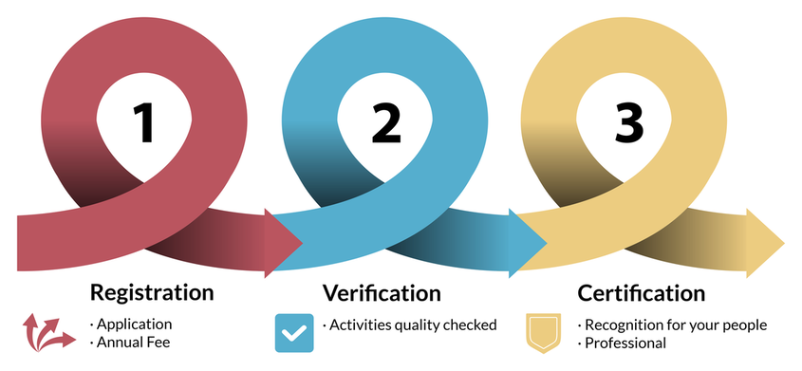
Accreditation process
Registration – Form CPD1 duly filled with accompanying documents and payment of Annual Fee submitted on or before 30th August;
Verification and quality check by PSC
If successful issuance of Certificate of Accreditation valid for 1 year.
Notes:
42

Slide 43
Accreditation Costs? Why Charge……….
To cover the costs for application review including all proposed programmes;
Facilitate the inclusion into the annual CPD calendar;
Facilitate quality assurance;
Deter applicants who may not have the financial capacity to offer proposed training;
Maintains the KISM Brand.
Notes:
43

Slide 44
Cost Benefit Analysis of Accreditation fees…..
KShs. 300,000 annual Accreditation Fees to facilitate the accreditation process and verification of all training proposed for accreditation by the PSC & KISM Secretariat.
KShs. 250 payable per CPD Hour to facilitate the inclusion of CPD hours into the KISM CPD automated system. Submission of participants by Accredited Providers.
The costs enable the accreditation process to be easily facilitated to pave the way for onboarding on the KISM Calendar and member alerts on upcoming trainings
Notes:
44

Slide 45
Cost Benefit Analysis of Accreditation charges
Global recognition: Accreditation can transcend borders and provide international recognition.
Continuous improvement: Accreditation can promote constant enhancement and demonstrate that an organization is continually working to improve the quality of its services.
Formal recognition: Accreditation can provide formal recognition by peers, both within the institution and across the country.
Notes:
45

Slide 46
Cost Benefit Analysis of Accreditation charges
Confidence: Accreditation can provide confidence that an organization is providing services that meet the highest standards.
Quality improvement: Accreditation can define risk stratification to ensure due diligence is undertaken to enhance quality of training.
Enrollment: Accreditation can lead to higher enrollment of participants.
Notes:
46

Slide 47
Benchmark with other professional bodies
LSK – KShs. 500,000 annual fee and cost of KShs. 1,000 per CPD Unit per Participant;
ICS – KShs. 200,000 initial application fee and annual renewal payment of KShs. 150,000
IHRM – KShs. 7,500 per CPD for physical workshops and KShs. 3,500 per CPD for webinars per participants
ICPAK – They do not accredit providers.
Notes:
47

Slide 48
Miscellaneous Provisions
Annual hours set at 40 for renewal – with an extension to 31st January
Event maximum of 30 CPD for everyone including accredited providers
Non-transferability of hours to other members by those in excess
Appeals to be channelled to the Council.
Notes:
48

Slide 49
In Conclusion…Why CPD?
Adaptation to Industry Changes
Enhanced relevance by aligning the content with the evolving needs
Meeting Diverse Learning Needs & preferences
Technology Integration to enhance accessibility and engagement
Alignment with Member Expectations
Globalization and Virtual Learning & collaborative tools
Promotion of Lifelong Learning & commitment to ongoing self-development
Enhance Competitive Advantage
Member Retention, Recruitment & Motivation
Quality Assurance & effectiveness of content
Alignment with industry standards and regulations

Slide 50
We are counting on you…
To help us stay relevant, meet the changing needs of our members, maintain a competitive edge in providing high-quality, up-to-date learning experiences
To help us revamp, innovate and differentiate the way we deliver our CPD Programs and enhance the value delivery to our Members

Slide 51
It’s Time…Time For SCM & for Africa to arise & shine…
Question: What Legacy do we want to bequeath the next generation of SCM Professionals???
KISM will be the Pan-African Centre of SCM Management

Slide 52
Q & A
Further Input and clarifications can be received via email at cpdreview@kism.or.ke

